Slide 1





Online Flight Booking Management System.
Course: CSE 3210
Course Title: Database System Laboratory
Name:Md Ashikul Islam
Roll:1909015
Yr-sem:3-2

Slide 2
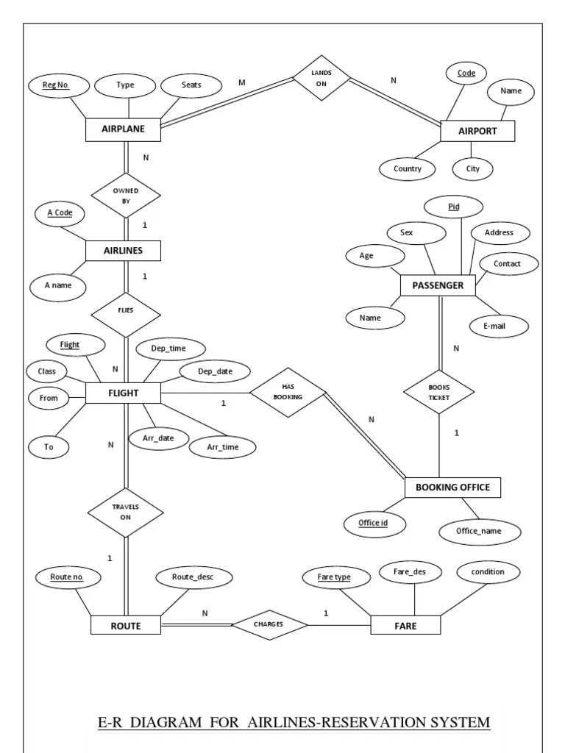
ER-DIAGRAM

Slide 3
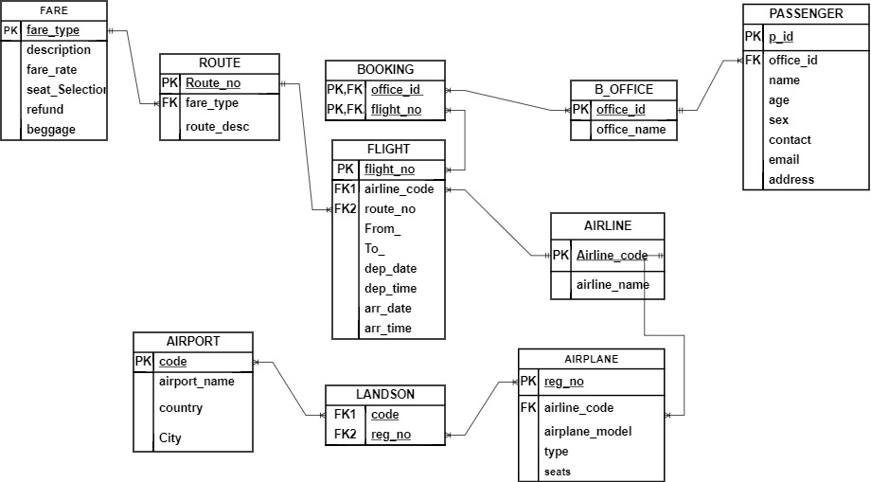
Relational Schema

Slide 4
Tables
Passenger Table
P_ID | OFFICE_ID | NAME | AGE | SEX | CONTACT | EMAIL | ADDRESS
15 | 101 | Ashik | 22 | Male | 1851498242 | islam1909015@stud.kuet.ac.bd | Dhaka
32 | 102 | Nabil | 22 | Male | 1898317404 | nabil1909032@stud.kuet.ac.bd | Dhaka
12 | 103 | Jahid | 22 | Male | 1701309390 | jahid1909012@stud.kuet.ac.bd | Madaripur
13 | 101 | Alvi | 22 | Male | 1558437420
Booking office
Airline Table
OFFICE_NAME | OFFICE_ID
GoZayaan | 101
Obokash | 102
Flight Expert | 103
AIRLINE_CODE | AIRLINE_NAME
BG | Biman Bangladesh Airline
BS | US Bangla Airline
VQ | Novoair
2A | Air Astra

Slide 5
Flight Table
FLIGHT_NO | AIRLINE_CO | ROUTE_NO | FROM_ | TO_ | DEP_DATE | DEP_TIME | ARR_DATE | ARR_TIME
BG147 | BG | V1234 | Dhaka | Chittagong | 12 NOV | 12:45 | 12 NOV | 1:25
QK420 | QK | V2568 | Dhaka | Dubai | 14 NOV | 22:40 | 15 NOV | 8:20
RouteTable
Booking Table
ROUTE_NO | FARE_TYPE | ROUTE_DESC
V1234 | Basic Economy | DAC to CGP
V4567 | Premium Economy | DAC to DEL to DXB
V6789 | Business Class | DAC to CXB
OFFICE_ID | FLIGHT_NO
101 | BG147
102 | BS333
103 | QK420

Slide 6
Fare Table
FARE_TYPE | DESCRIPTION | FARE_RATE | SEAT_SELECTION | REFUND | BEGGAGE
Basic Economy | cheapest | 2500 | NO | NO | 15kg
Economy | Standard | 3000 | NO | Limited | 20kg
Business Class | Delux | 5000 | YES | FULL | 30kg
Airline Table
Landson
AIRLINE_CO | AIRLINE_CODE | AIRPLANE_MODEL | TYPE | SEATS
S2_ABCD | BG | Boeing-777 | commercial airline | 180
S2_BCDE | BS | Airbus-320 | commercial airline | 250
S2_EFCD | QK | Boeing-747 | commercial airline | 150
CODE | REG_NO
DAC | S2_ABCD
CGP | S2_CDAD
ZYL | S2_EFCD

Slide 7

Airport Table
CODE | AIRPORT_NAME | COUNTRY | CITY
DAC | Shahjalal airport | Bangladesh | Dhaka
ZYL | Dubai Int. Airport | UAE | Dubai
DEL | Indira Gandhi Airport | India | Delhi

